Slide 1
Modification I: Post-proces Engine
#MUL in Convolution/FC
#MUL in Post Process
One-time BN/Bias/Act. Function/Element Process can be pipelined after convolution/FC calculation.
Rest post process are computed by accessing the features
from FMemory individually.
Save 32 FP multipliers and adders

Slide 2
Modification I: Post-process Engine
#MUL in Convolution/FC
#MUL in Post Process
One-time BN/Bias/Act. Function/Element Process can be pipelined after convolution/FC calculation.
Rest post process are computed by accessing the features
from FMemory individually.
Save 32 FP multipliers and adders

Slide 3
Modification II: CRS Decoding
(c) Shift (4-16 decoder) before And : 32 4-16 decoders
(d) PE IDX Shift and IDX Set: 1 5-32 decoders
Save 16x decoding logic and intermediate result buffer (8.4x in Synthesis)

Slide 4
Debug I: Clock gating
Computing multiplication in one MAC of Dual PE or Post-process Engine:
The adder logic in the diagram will inverse along with the multiplier output.
Add another ADD_SRC1 register to gate the adder.

Slide 5
Debug II: Dual PE Enable Signal
When processing FC/Conv without sparsity, the PE array receives synchronous PE enable signals (MUL_EB and ADD_EN).
The randomly distributed conflicted weights require asymmetric PE Enable signals.

Slide 6
DLA SoC A
CPU can not access DRAM directly;
Data on DRAM <-> DLA GB
<-> CPU;
The SoC must access the DLA on-chip buffer.

Slide 7
DLA SoC B
CPU accesses DDR directly through AXI-4 and PHI bus.
CPU accesses DLA directly through AXI-4 and AXI-DLA bridge.
DLA accesses DDR directly through PHI bus.

Slide 8
DLA Interface
Multiplex bus as Data and Address bus;
MOSI and MISO control signals indicate data transfer direction and connect with off-chip interface.

Slide 9
DDR Rate
DDR | Bus Clock (MHz) | Internal Rate (MHz) | Transfer Rate (MT/s) | Voltage
DDR | 100-200 | 100-200 | 200-400 | 2.5
DDR2 | 200-533 | 100-266 | 400-1066 | 1.8
DDR3 | 400-1066 | 100-266 | 800-2400 | 1.5
DDR4 | 800-1200 | 200-300 | 1600-5067 | 1.2

Slide 10
Next Plan
64-bit or 32-bit data bus is suitable for off-chip feature/weight access: modify the 256-bit input/output bus to 64/32-bit inout bus.
Fix the DDR-DLA PHI interface.
Time Schedule
RTL Freeze | 3.12
Simulation with dummy data | 3.20
Mapping first LSTM/CNN | 4.15
Backend | 5.15

Slide 11
2019.3.8

Slide 12
Debug I: Padding
Zero Padding: No storage required but calculated.
Bug: Padding Enable sets to high (send 0 to PE) when Feature Address Counter starts counting (send F0 to PE).
Fix: Delay the feature address until Padding Enable sets to low.
Add a padding state to the COMP FSM.

Slide 13
Debug II: Conv Enable near Computing Completion
(a): Ideal case: high MAC utilization.
(b): W1*A4 W2*A5 is useless. Low MAC utilization when gating
Do not occur in Conv 2x1.
Lower MAC utilization with larger weight size.

Slide 14
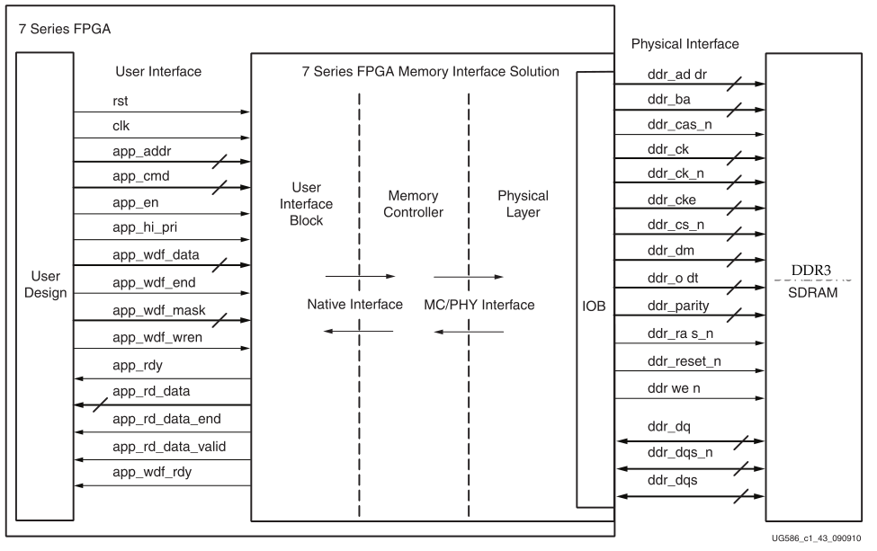
DDR3 Interface

Slide 15
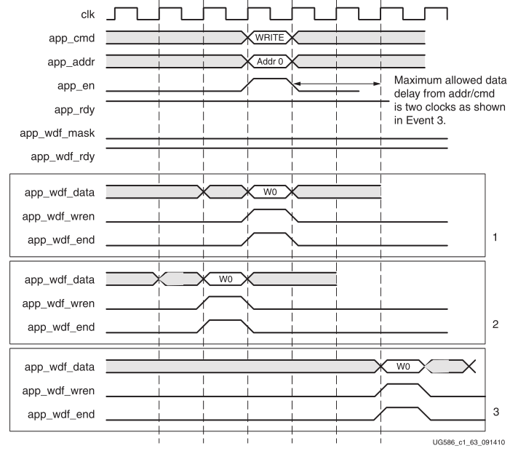
DDR3 Write Sequence

Slide 16
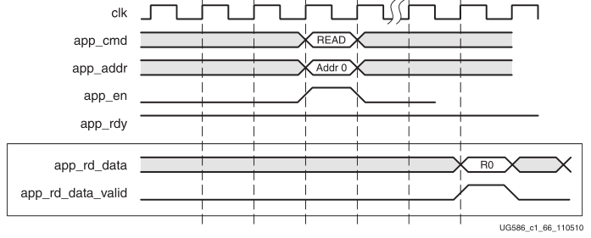
DDR3 Read Sequence

Slide 17
2019.3.11

Slide 18
Dataflow
Time Dimension:
(a)Wavenet: Feature Width
(b)LSTM: Batch Size

Slide 19
Dataflow
Convolution: Time Slice->OC->IC
LSTM: Time Slice->OC->IC
User can set #TLen #OC #IC to compute one slice.

Slide 20
DLA Model
#OC>32, #IC>16
Feature and Weight flow past DLA periodically.
2. Three Stage Accumulation
Acc1: Mul in one kernel Window.
Acc2: Psum from different input channel.
Acc3: Psum update with different slice.
Acc 2
Acc 3
Acc 1

Slide 21
Sparsity
One conflict weight (Cn) in one combined row.
16 conflict weights in 32 output channels.
The number of combined channel can be set independently for different combine regions of the same layer.

